Slide 1
TEXplorer: Keyword-based Object Search and Exploration in Multidimensional Text Databases
Date: 2012/05/14
Source: Bo Zhao et. al (CIKM’11)
Speaker: Chiang,guang-ting
Advisor: Dr. Koh. Jia-ling

Slide 2
Index
Introduction
Tasks of TEXplorer
Significance of A Dimension
Ranking Algorithms
Experiment
Conclusions

Slide 3
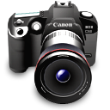
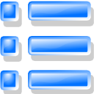
Introduction
Multi-dimensional text database
Notes:
由於網路快速發展，現於網路上存在大量的資料，而有許多資料是具有豐富的結構化屬性，像產品評論…

Slide 4
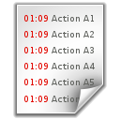
Introduction
attribute
Not helpful
TEXplorer
Notes:
對於這種類型的資料，現在較流行的搜尋方法是讓使用者藉由選擇某”維度”來進行相關性的排名，並回傳結果給使用者 但有時並不是太有幫助

Slide 5
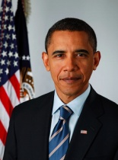
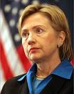
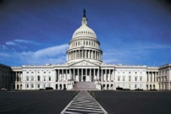
Tasks of TEXplorer
TEXplorer
Integrating keyword-based ranking and OLAP exploration.
TEXplorer System
Healthcare
Reform
Top-1 Dimension: Person
Top-2 Dimension: Org
Top-3 Dimension: Time
2010
2008
2004
Notes:
藉由選擇某維度的屬性直，分析落在此維度值的文件，對其他屬性計算與查詢字相關的前k高的屬性值

Slide 6
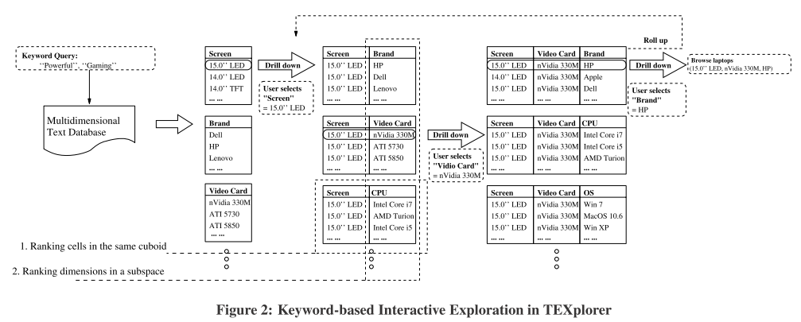
Notes:
系統實例

Slide 7
Tasks of TEXplorer
Ranking dimensions for drilling down
Ranking values in the same dimension
Notes:
系統主要工作

Slide 8
Significance of A Dimension
doc
(q,cell’s doc)
TEXplorer System
Healthcare
Reform
Top-1 Dimension: Person
(q,cell)
Top-2 Dimension: Org
Top-3 Dimension: Time
2010
2008
2004
Notes:
考慮兩個feature
在同一維度底下
1.屬性質跟查詢字的關係
2.此屬性質所屬的文件與查詢字的關係

Slide 9
Significance of A Dimension
Cell variance
how much the relevance of each of C’s Ai-children deviates from the relevance of C
${chd}_{A_{i}}$(C):denote the set of children in $A_{i}$of C.
$C_{d}$:document of cell C.
IDF:inverted document frequency factor of term w∈q.
TFW:term frequency factor of w in document d.
QTW:the query term frequency factor of w in q.

Slide 10
q=“game”, “playing”
C= “16’0 LED”
SCREEN
16’0 LED | d1,d2,d3,d4,d5
BREND
DELL | d1,d2
HP | d3
acer | d4,d5
Rel(q,C)=$\frac{1}{5}∗\left(rel\left(q,d1\right)+rel\left(q,d2\right)+…\right)$
rel(q,d1)=${IDF}_{game}∗{TFW}_{game}∗{QTW}_{game}$+
$${IDF}_{playing}∗{TFW}_{playing}∗{QTW}_{playing}$$
=$\log{\frac{5}{1}∗\frac{3}{100}∗\frac{1}{2}+\log{\frac{5}{2}∗\frac{10}{100}∗\frac{1}{2}}}=0.02985$
$${CV}_{BREND}(q,C)=\frac{2∗0.3+1∗0.2+2∗0.1}{3−1}$$
OS
XP7 | d1
MacOs | d2,d3
XP | d4,d5

Slide 11
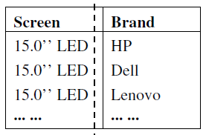
Significance of A Dimension
Document variance
how much the relevance of each document in C deviates from the relevance of the Ai-child of C which contains that document.

Slide 12
q=“game playing”
C= “16’0 LED”
SCREEN
16’0 LED | d1,d2,d3,d4,d5
BREND
DELL | d1,d2
HP | d3
acer | d4,d5
$${IDV}_{BREND}(q,C)=\frac{5−3}{a+b+c}$$
a=${\text{(}\text{rel}\text{(}\text{q}\text{,}\text{d}\text{1)−}\text{Rel}\text{(}\text{q}\text{,}\text{Dell}\text{))}}^{2}+{\text{(}\text{rel}\text{(}\text{q}\text{,}\text{d}\text{2}\text{)−}\text{Rel}\text{(}\text{q}\text{,}\text{Dell}\text{))}}^{2}$
b=${\text{(}\text{rel}\text{(}\text{q}\text{,}\text{d}\text{3}\text{)−}\text{Rel}\text{(}\text{q}\text{,}\text{HP}\text{))}}^{2}$
c=${\text{(}\text{rel}\text{(}\text{q}\text{,}\text{d}\text{4}\text{)−}\text{Rel}\text{(}\text{q}\text{,}\text{acer}\text{))}}^{2}+{\text{(}\text{rel}\text{(}\text{q}\text{,}\text{d}\text{5}\text{)−}\text{Rel}\text{(}\text{q}\text{,}\text{acer}\text{))}}^{2}$
OS
XP7 | d1
MacOs | d2,d3
XP | d4,d5

Slide 13
Significance of A Dimension
1
doc
TEXplorer System
Healthcare
Reform
Top-1 Dimension: Person
Top-2 Dimension: Org
Top-3 Dimension: Time
2010
2008
2004

Slide 14
Notes:
針對具有豐富結構化屬性的文件資料庫進行關鍵字的查詢，跟一般查詢不同的是他回傳的不是依相關度排序的文件，而是提供一瀏覽介面提供與查詢字相關的維度資訊及資料細節來幫助使用者搜尋有興趣的資料。
屬性的排名是依照查詢字與各屬性的相關度決定，屬性相關度衡量的基準有二: 一是考慮查詢字與此屬性的屬性值的相關度，另一則是分布在此屬性值底下的文件與查詢字的相關程度

Slide 15
Ranking Algorithms
MultiAccess Algorithm
q=“game” , “playing”
SCREEN
15’0 LED | d1,d2,d3
14’0 LED | d4
14’0 TFT | d5
1.Fetch the doc related with q
2.${Sig}_{SCREEN}$ , ${Sig}_{BREND}$ , ${Sig}_{OS}$ get RANKING
3.Return Top-K
1.Fetch the doc related with q and C
2. ${Sig}_{BREND}$ , ${Sig}_{OS}$ get RANKING
3.Return Top-K
BREND
DELL | d1,d2
HP | d3
acer | d4,d5
OS
XP7 | d1
MacOs | d2
XP | d3
BREND
DELL | d1,d2
HP | d3
OS
XP7 | d1
MacOs | d2,d4
XP | d3,d5

Slide 16
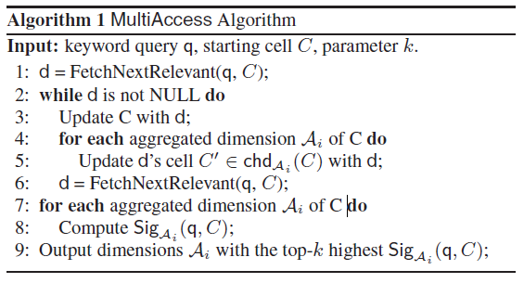
Ranking Algorithms
MultiAccess Algorithm

Slide 17
Ranking Algorithms
R$el(q,C′)$
OneAccess Algorithm

Slide 18
Ranking Algorithms
OneAccess Algorithm
q=“game” , “playing”
SCREEN
15’0 LED | d1,d2,d3
14’0 LED | d4
14’0 TFT | d5
1.Precompute each doc’s TFW, IDF then could precompute rel ,Rel……
2.Fetch the doc related with q
3.${Sig}_{SCREEN}$ , ${Sig}_{BREND}$ , ${Sig}_{OS}$ get RANKING
4.Return top-k
1.Fetch the doc related with q and C
2. ${Sig}_{BREND}$ , ${Sig}_{OS}$ get RANKING
BREND
DELL | d1,d2
HP | d3
acer | d4,d5
BREND
DELL | d1,d2
HP | d3
 | TFW | IDF
d1 | 0.3 | 0.1
d2 | 0.5 | 0.2
d3 | 0.2 | 0.3
d4 | 0.1 | 0.2
d5 | 0.2 | 0.4
OS
XP7 | d1
MacOs | d2,d3
XP | d4,d5
OS
XP7 | d1
MacOs | d2
XP | d3

Slide 19
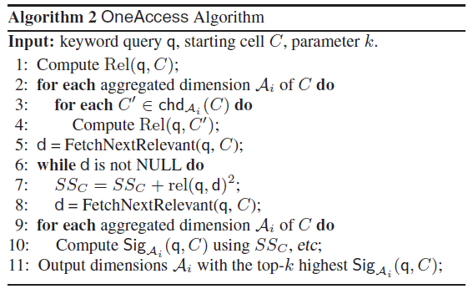
Ranking Algorithms
OneAccess Algorithm

Slide 20
Ranking Algorithms
OneAccess+ Algorithm
progressively fetch documents in the descending order of their relevance scores
${df}_{w,c}:$number of documents in C that contain w

Slide 21
For each ordered documents(by relevance)(d4>d5>d1>d2>d3)
Upper bound Sig
Upper bound List
Lower bound Sig
Lower bound List
$$L_{UB}$$
$$L_{LB}$$
$$L_{LB}$$
[k]
$$L_{UB}$$
[k+1]
≥

Slide 22
q=“game” , “playing”
Screen:
rel: d4>d5>d1>d2>d3
Top-2 attribute
SCREEN
15’0 LED
14’0 LED
14’0 TFT
$$L_{UB}$$ | $$L_{LB}$$
SCREEN | SCREEN
BREND | OS
OS | BREND
$$L_{UB}$$ | $$L_{LB}$$
SCREEN | SCREEN
BREND | BREND
OS | OS
d4
d5
BREND
DELL
HP
acer
$$L_{LB}\left[2\right].score≥L_{UB}\left[3\right].score$$
d4
d5
OS
XP7
MacOs
XP
d4
d5

Slide 23
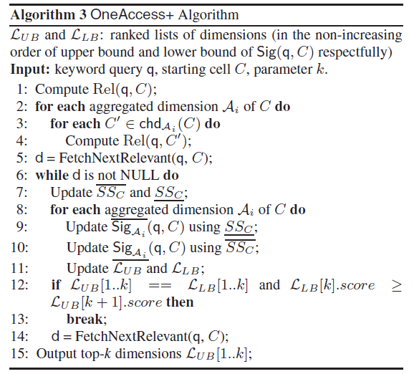
Ranking Algorithms
OneAccess+ Algorithm

Slide 24
Ranking Algorithms
OneAccess++ Algorithm

Slide 25
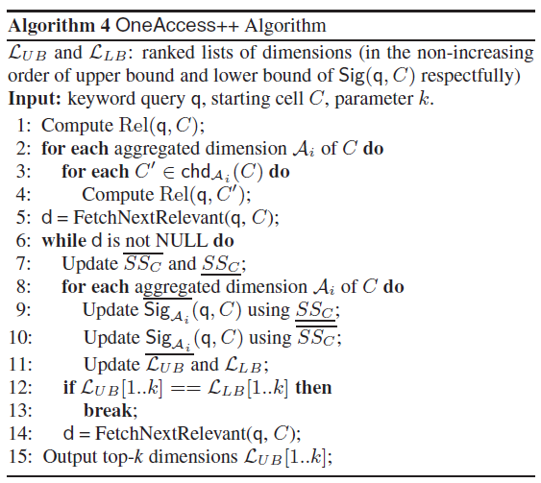
Ranking Algorithms
OneAccess++ Algorithm

Slide 26
Ranking Algorithms
Algorithm | difference
MultiAccess Algorithm | Baseline approach.
OneAccess Algorithm | The relevance of cells can be computed without scanning any document.
OneAccess+ Algorithm | Exploits upper and lower bounds to enable early termination of the algorithm when top-k is guaranteed.
OneAccess++ Algorithm | The stop condition is different.

Slide 27
Experiment
Analyse the performance of our proposed algorithms.(Effectiveness)
Verify the effectiveness of our ranking mechanisms.(Efﬁciency)

Slide 28
Experiment
Dataset
Customer reviews for laptops from Google Products.
The dataset has 26,418 reviews, 920 laptops.
11 dimensions:
Audio Card, Battery Run Time, Brand, Screen Type, Color, Weight, Operating System, CPU, Hard Drive, Main Memory and Video Card.

Slide 29
Experiment
Effectiveness
Compare our signiﬁcance measure with the dimension ranking functions in two recent faceted search systems.
Indg(indistinguishable)
targets on building decision trees with minimum height on the tuples, so that users’ efforts to reach each individual tuple can be minimized.

Slide 30
Experiment
Intr(interestingness)
estimates the probability of the query results using a hypergeometric distribution.
A smaller p-value indicates it is less likely to get the results by chance, and therefore the cell C is more interesting.

Slide 31
Experiment

Slide 32
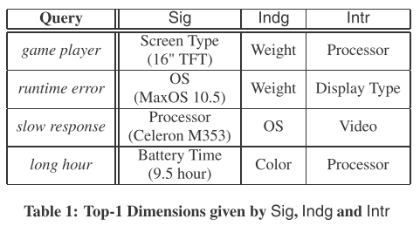
Experiment

Slide 33
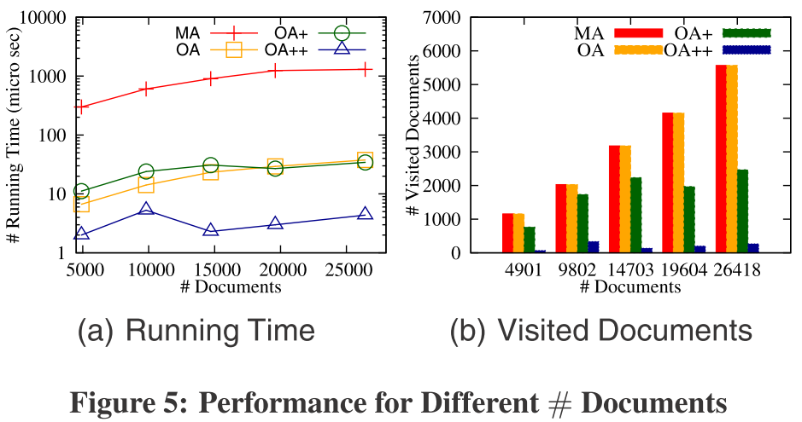
Experiment
Efﬁciency
Efﬁciency vs. Number of Documents
issue 10 queries of length 3

Slide 34
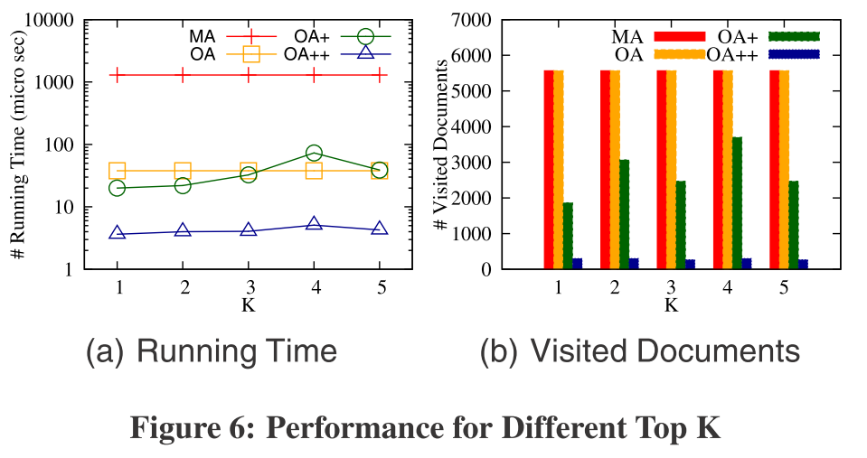
Experiment
Efﬁciency
Efﬁciency vs. Top-k

Slide 35
Conclusions
Propose a novel system TEXplorer that allows users to perform keyword search and OLAP-style aggregation and exploration of the objects in a text cube built on a multidimensional text database.
A novel signiﬁcance measure is proposed to rank dimensions. Top relevant objects/cells in each dimension subspace are also ranked for users to select.
We develop top-k algorithms and materialization strategies to accelerate the ranking.
Extensive experimental studies verify the scalability of our methods and the effectiveness of our proposed signiﬁcance measure.

Slide 36
Thanks for your listening

Slide 37
Supplement

Slide 38
Precision
舉個例子：假設現在資料庫中有10000筆資料，和美食有關的文章有500篇。
使用者在輸入美食的關鍵字後，回傳的文章有4000篇，其中有400篇是和美食有關的。
Precision = 400 / 4000 = 10%
Recall = 400 / 500 = 80%

